Slide 1
NFL Combine vs. NFL Draft Analysis
Bill, Olivia, Rob and Satchith
May 8th, 2019

Slide 2
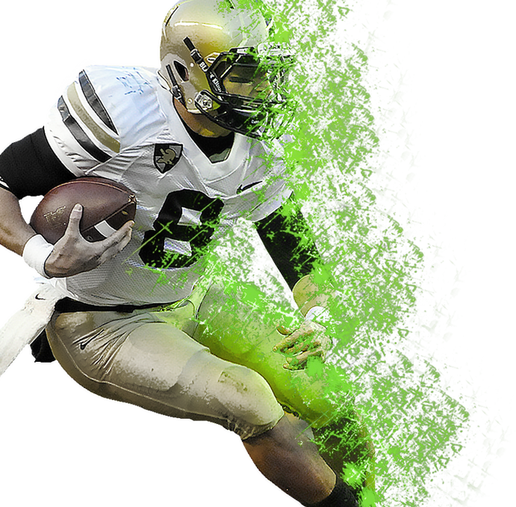
Rundown
01
Purpose
The “why” of our presentation; what are we looking to find and why is it important?
02
Strategy
The “how” of our presentation; the structure of the research and how we are going to use the data we find
03
Analysis
The “who, what, when and where” of our presentation; the actual dive into our data following the strategy of how to find it
04
Findings
What this is all about; our conclusion and why it matters in today’s sports era

Slide 3

Notes:
Celebrating 100 years of the NFL

Slide 4
Purpose
The “why” of our presentation; what are we looking to find and why is it important?

Slide 5
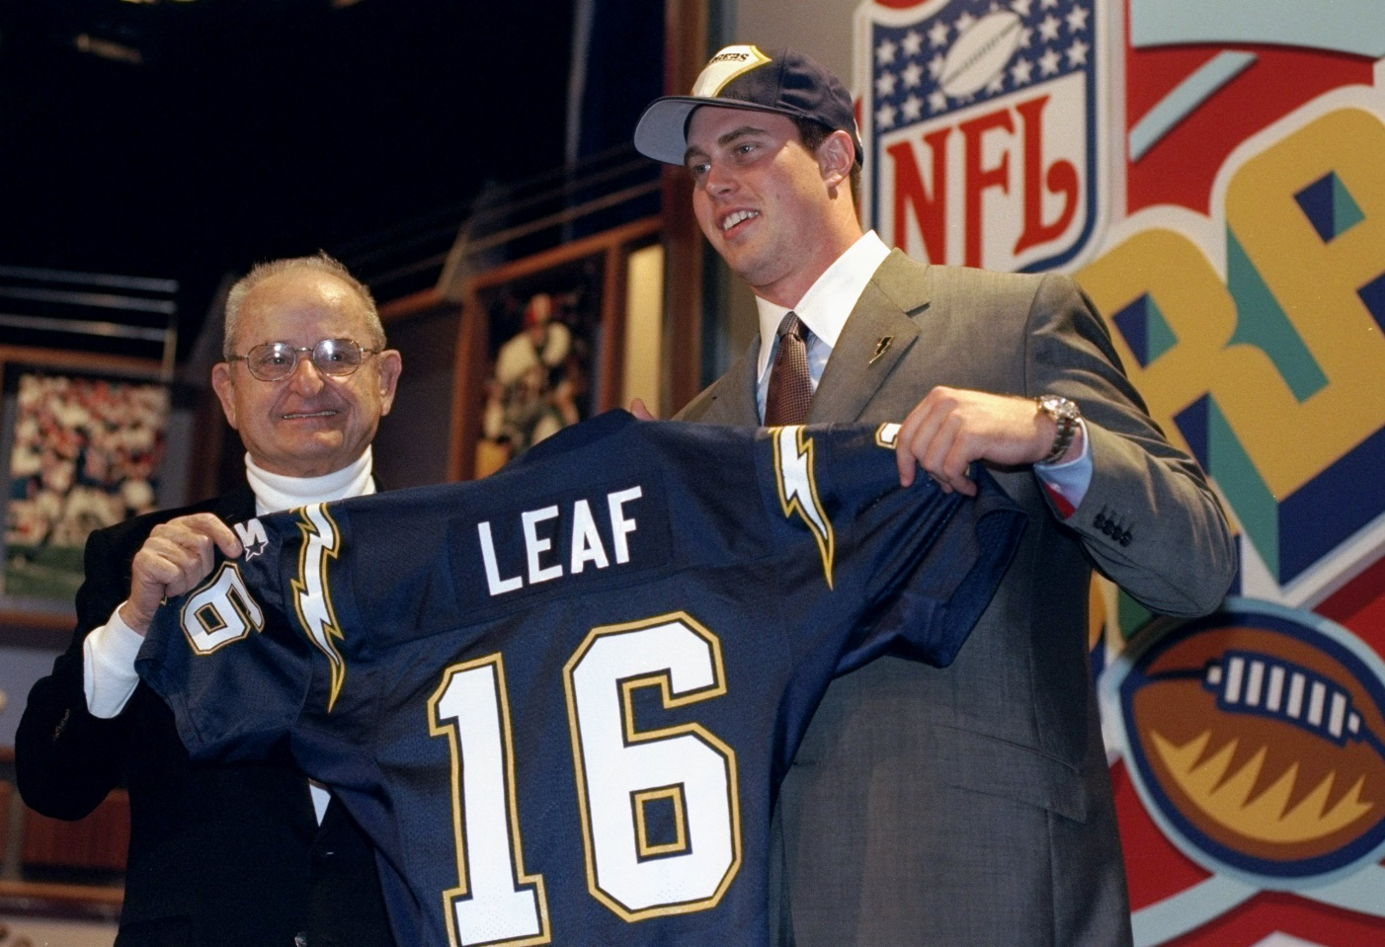
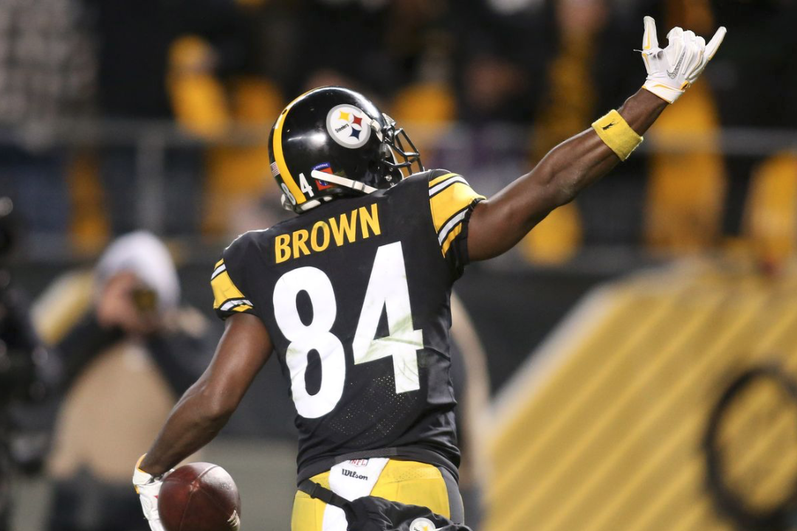
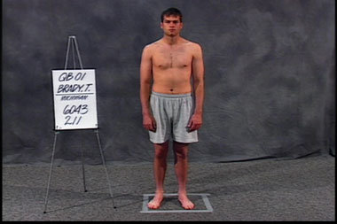
What Are You Getting?
2nd Overall Pick in the 1998 NFL Draft
$31.25 Million Contract ($11.25 signing bonus)
Career:
Started 21 Games
48.4 Comp %, 3,666 Passing Yards,
14 TD, 36 Int, 0 Playoff Games
195th Overall Pick in the 2010 NFL Draft
$1.28 Million Contract ($73,075 signing bonus)
Career:
Played in 130 Regular Season Games
837 Rec, 11,207 Receiving Yards, 74 TD
10 Playoff Games, 51 Rec, 837 Yds, 4 TD
199th Overall Pick in the 2000 NFL Draft
$193,000 Contract ($38,500 signing bonus)
Career:
Started 267 Regular Season Games
64.0 Comp %, 70,514 Passing Yards, 517 TD
40 Playoff Games, 11,179 Yds, 73 TD
6 Super Bowl Titles

Slide 6
Timeline of NFL Events
Based on the 2018-2019 NFL Calendar
*Subject to change in 2019-2020
Declaration
NCAAF Ends
NFL Combine
NFL Draft
Start of Season
January 14th
January 26th
February 26th – March 4th
April 25th – April 27th
September 5th
Declaration Day
Senior Bowl
NFL Combine
NFL Draft
Packers @ Bears
Last day for underclassmen to declare for the NFL Draft
Ladd Peebles Stadium, Mobile, AL
Lucas Oil Stadium, Indianapolis, IN
Nashville, TN
Soldier Field, Chicago, IL

Slide 7
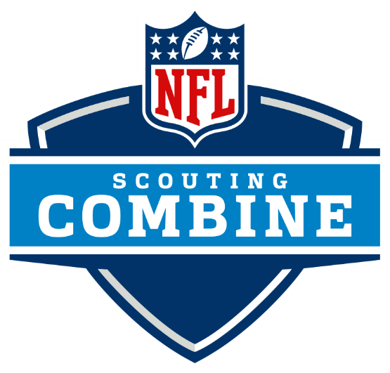
NFL Combine
C
NFL Scouting Combine
The NFL Scouting Combine is a week-long showcase occurring every February at Lucas Oil Stadium in Indianapolis, where college football players perform physical and mental tests in front of National Football League coaches, general managers, and scouts. With increasing interest in the NFL Draft, the scouting combine has grown in scope and significance, allowing personnel directors to evaluate upcoming prospects in a standardized setting.

Slide 8
Wonderlic
Intelligence test used to assess the aptitude of prospective players
Drills Measured
NFL Combine Drills
Bench Press
40 Yard Dash.
Bench Press
Vertical Leap
Broad Jump
Shuttle
3 Cone Drill
60 Yard Shuttle
Upper-body strength training exercise that consists of pressing a weight upwards from a supine position
Hand Size
Measurements to show how well one can transition to a larger ball in the NFL
What do these drills actually measure and what are scouts looking for?
Vertical Leap
Explosive lower body measurement to gauge how high and individual can elevate off the ground from standstill
40 Yard Dash
Straight-line speed drill to evaluate acceleration and top-end velocity of prospects
3 Cone Drill
Sharp turning drill to evaluate the agility, quickness and fluidity of movement of players

Slide 9
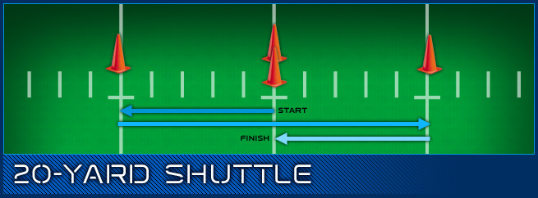
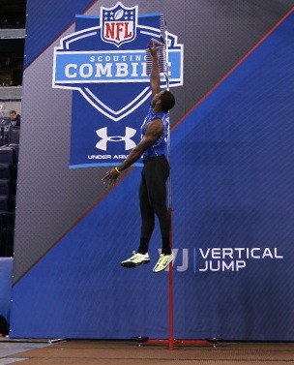
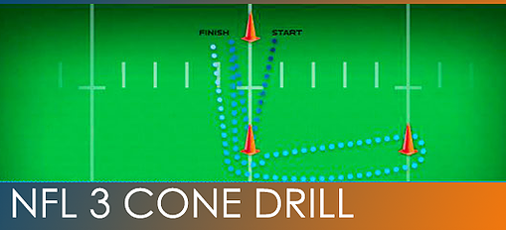

Slide 10
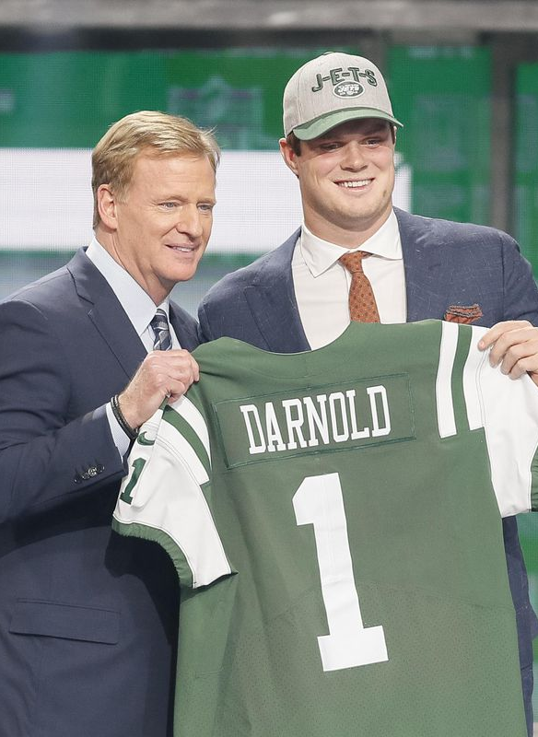
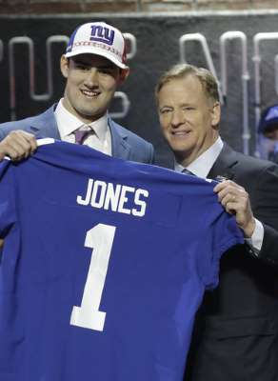
NFL Draft
How Does
The NFL Draft
Process Work?
As per the NFL operations department, they define the NFL Draft rules as such:
“Currently, each of the 32 clubs receives one pick in each of the seven rounds of the NFL Draft (the number of teams drafting has changed over time, and there have been as many as 30 rounds in a single draft).
The order of selection is determined by the reverse order of finish in the previous season. Barring any trades between clubs, each round starts with the team that finished with the worst record and ends with the Super Bowl champions.”

Slide 11
Strategy
The “how” of our presentation; the structure of the research and how we are going to use the data we find

Slide 12

01
Approximate Value: Methodology
The Approximate Value (AV) is Doug Drinen's method of putting a single numerical value on any player's season, at any position, from any year. The number is derived from a deep dive on individual and team performances at any given time during a game.
The AV of a player is determined based on many different factors. The statistical formulas drastically vary.
Here is a quick snapshot of how everything plays out:
Doug Drinen has a B.A. from Trinity University in Texas and a Ph.D. from Arizona State University. After a two year post-doc at Dartmouth College, he came to Sewanee in 2001. He greatly enjoys teaching across the entire undergraduate mathematics curriculum. During his time at Sewanee, his research interests have shifted from functional analysis to probability, graph theory, economics, and any other area in which he can find problems to work on with students and colleagues.

Slide 13
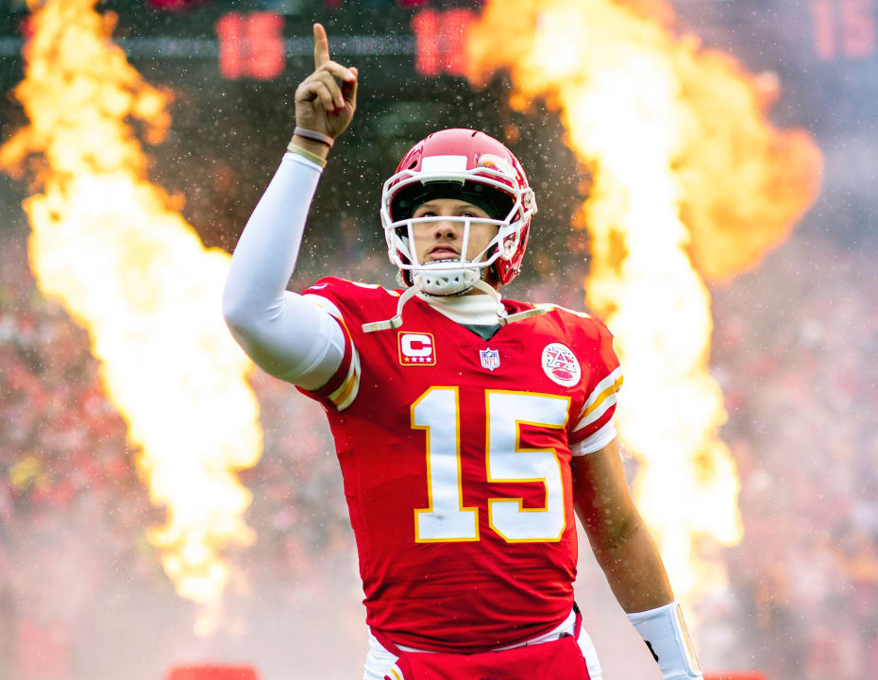
Offense
Every team gets this many points to divvy up among its offensive players:
team_offense_points =
100 * (team offensive points per drive) / (league average offensive points per drive),
where:
offensive points per drive =
(7*(rushTD+passTD) + 3*FG) / (rushTD + passTD + turnovers + punts + FGA)

Slide 14
Splitting Up Those Points…
Offensive Line
Receivers
approx_value = (individual_points) / (sum of individual_points for all players on team) * (team_points_for_o_line)
Rushers
approx_value =
(receiving yards) / (team receiving yards) * team_points_for_receivers
Passers
approx_value =
(rushing yards) / (team rushing yards) * team_points_for_rushers
approx_value =
(passing yards) / (team passing yards) * team_points_for_passers

Slide 15
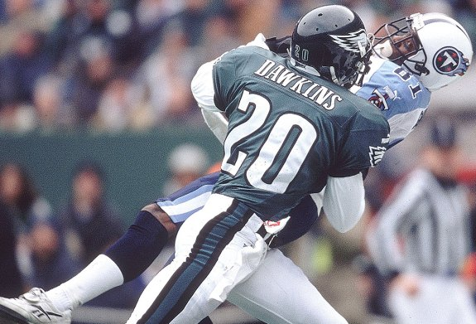
Defense
Every team gets this many points to divvy up among its defensive players:
team_defense_points =
100 * [ (1 + 2 M - M^2) / (2 M) ]
where:
M = (team defensive points allowed per drive) / (league average defensive points allowed per drive)

Slide 16
Splitting Up Those Points…
01
Team Points for Front 7
02
Approximate Value for Individual
Front 7
AV
Secondary
AV
(2/3) * team_defense_points
[ (individual points) / (sum of individual points for all front-seven players on the team) ] * team_points_for_front_7
(1/3) * team_defense_points
[ (individual points) / (sum of individual points for all defensive backs on the team) ] * team_points_for_
secondary
03
Team Points for Secondary
04
Approximate Value for Individual

Slide 17
Analysis
The “who, what, when and where” of our presentation; the actual dive into our data following the strategy of how to find it

Slide 18

Analysis
Merge Data for Analysis
Cleaning through data from every combine from 1987 to 2015 and merging it with First4AV data and 2019 combine data
Analyze First4AV Data
Determine the best and worst First4AV value players at respective positions and average their combine and physical measurements to create an “ideal” and “non-ideal” player
Shoot The Gap
Find the largest percent change gap between the “ideal” and “non-ideal” combine scores and measurements to create a weighted scale per position
Prediction
Use the new weighted scale to project how prospects from the 2019 NFL Draft will produce in the first 4 years of their rookie contracts

Slide 19
Distribution
Bill
Olivia
Rob
Satchith
Tight Ends
Defensive Backs
Defensive Tackles
Quarterbacks
Wide Receivers
Offensive Linemen
Defensive Ends
Running Backs
Linebackers
TE, DB, DT
QB, WR
OL, DE
RB, LB

Slide 20
Findings
What this is all about; our conclusion and why it matters in today’s sports era

Slide 21
TE, DT, DB

Slide 22
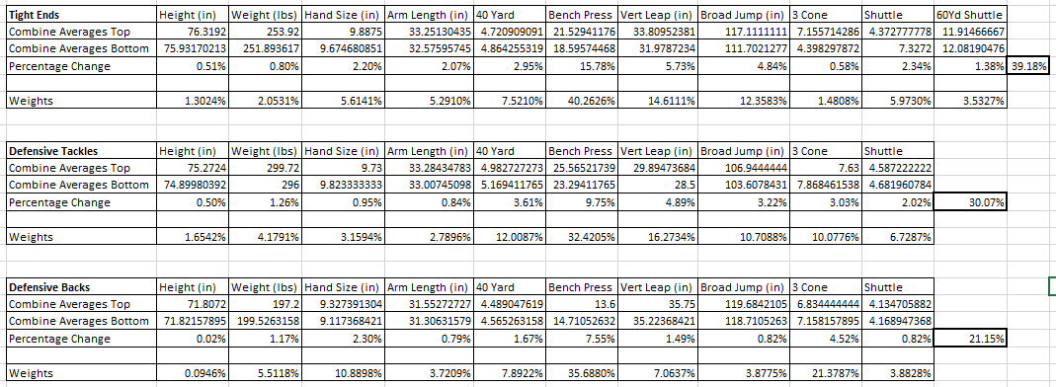
Tight End, Def Tackle and Def Back Weights

Slide 23
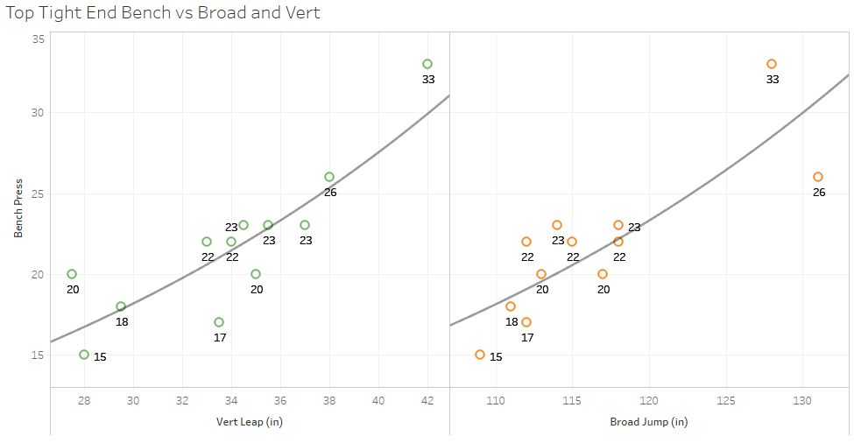

Slide 24
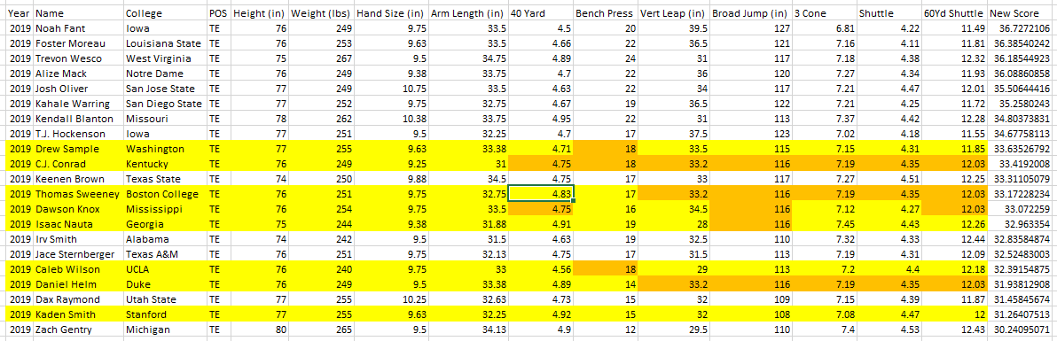
Tight End Projections

Slide 25
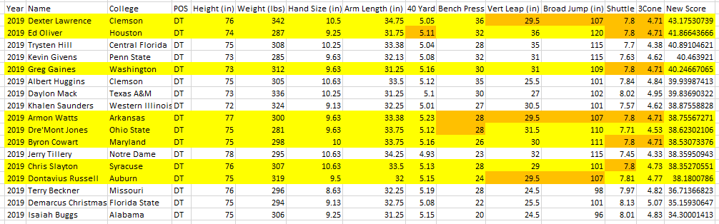
Defensive Tackle Projections

Slide 26
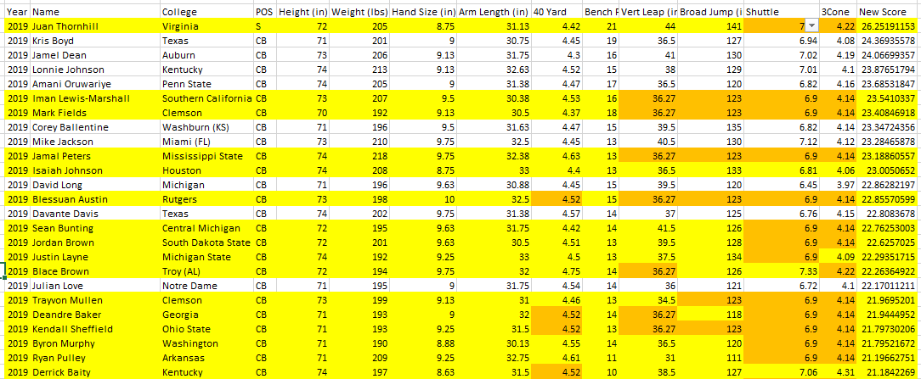
Defensive Back Projections

Slide 27
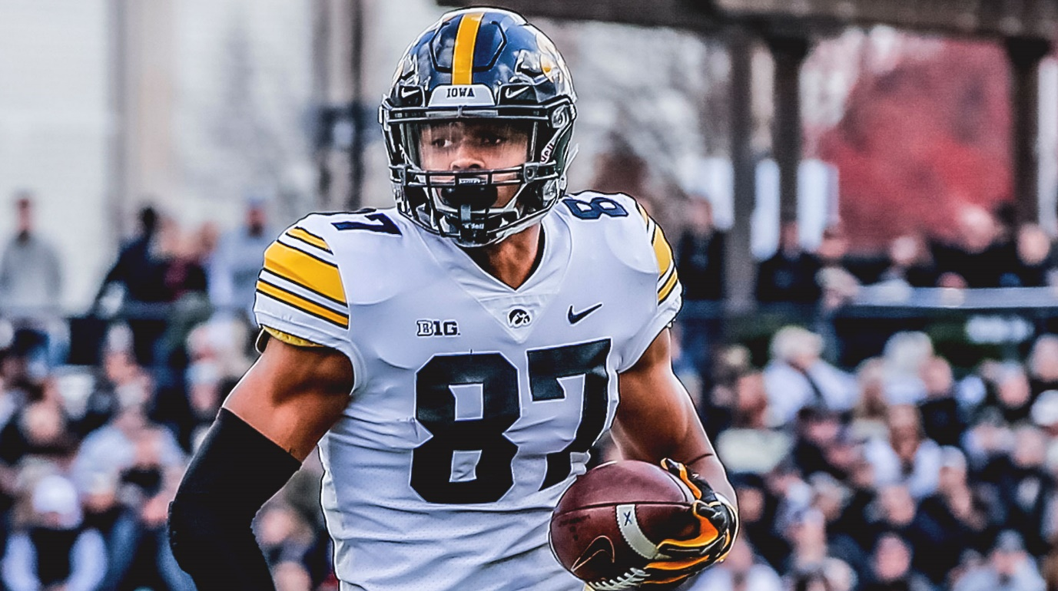
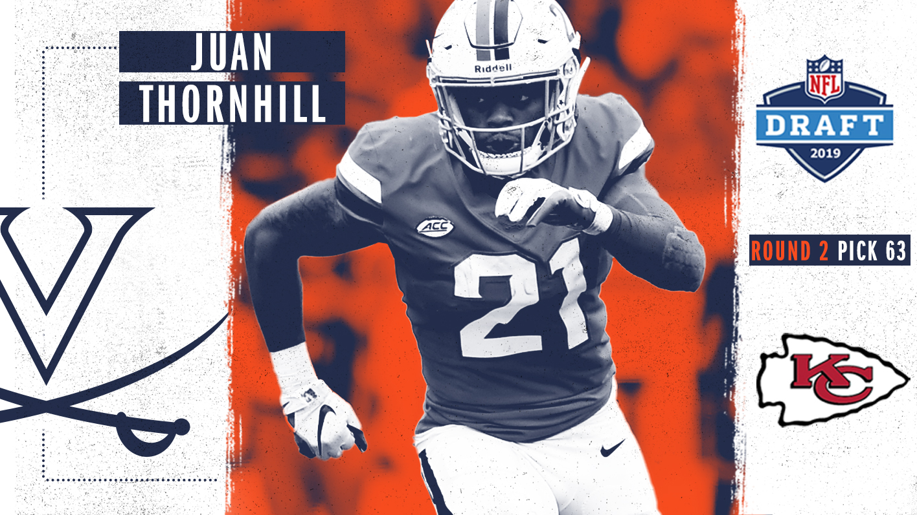
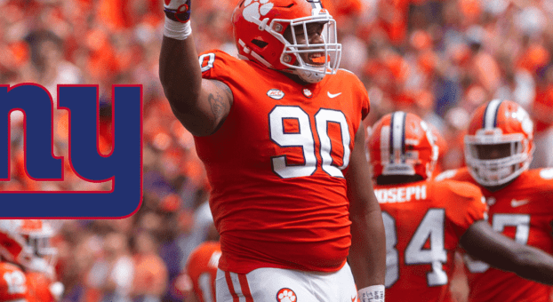
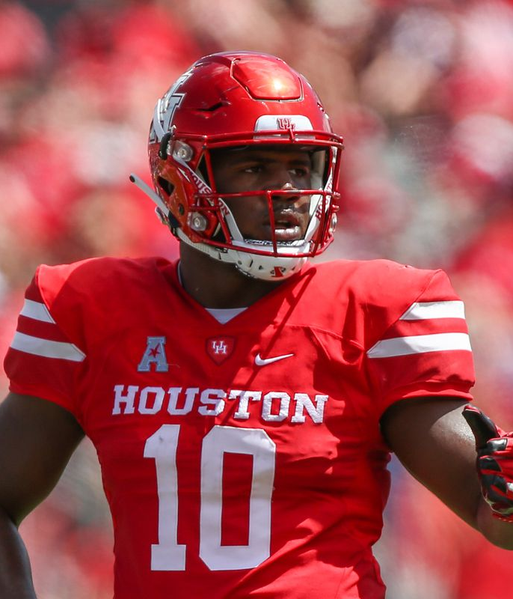
0
Where Did They Go?
Where They Got It Right
Noah Fant – 1st Round – 20th Overall – Denver Broncos
Ed Oliver – 1st Round – 9th Overall – Buffalo Bills
Juan Thornhill – 2nd Round – 63rd Overall – Kansas City Chiefs
Dexter Lawrence – 1st Round – 17th Overall – New York Giants

Slide 28
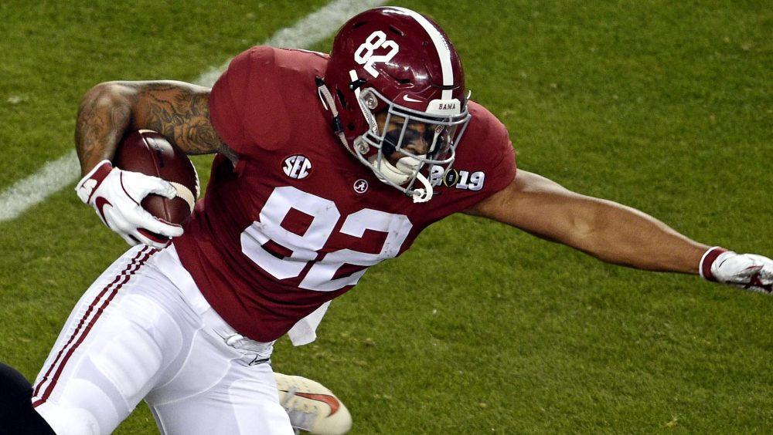
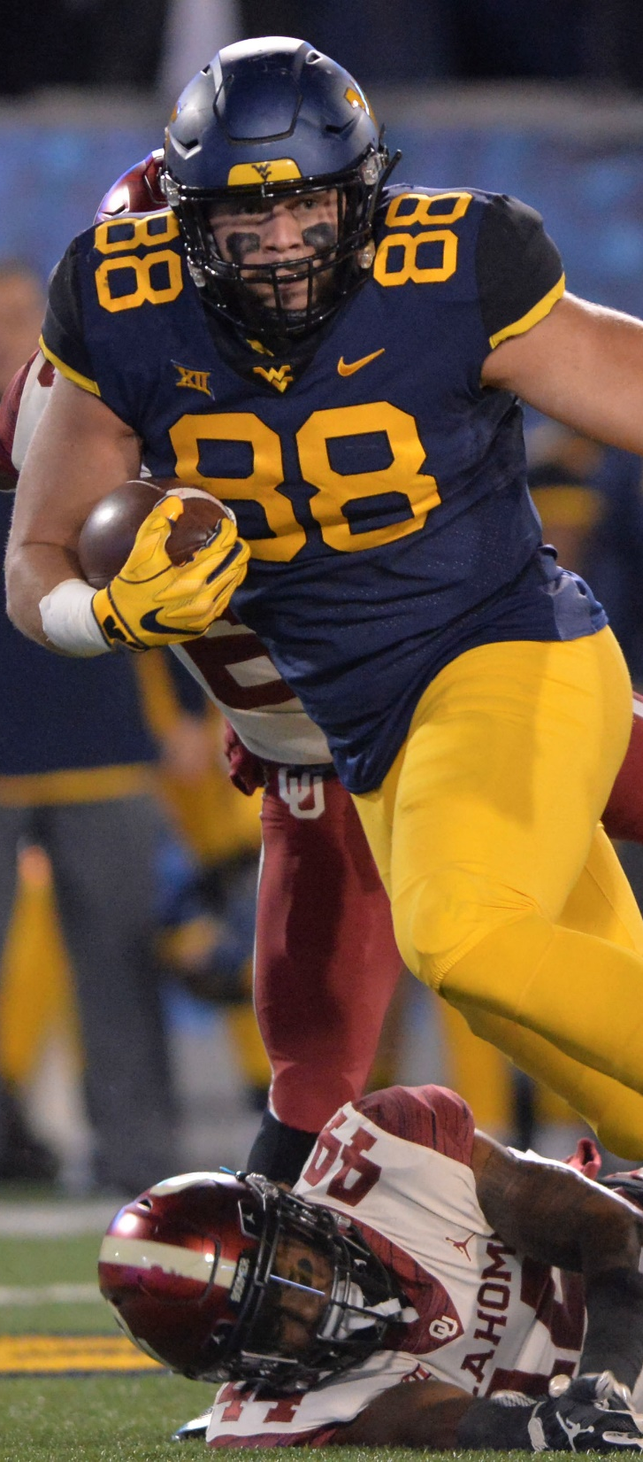
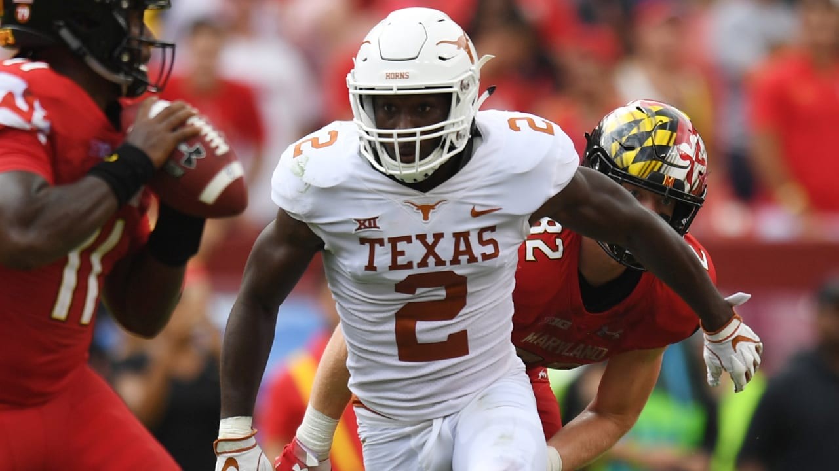
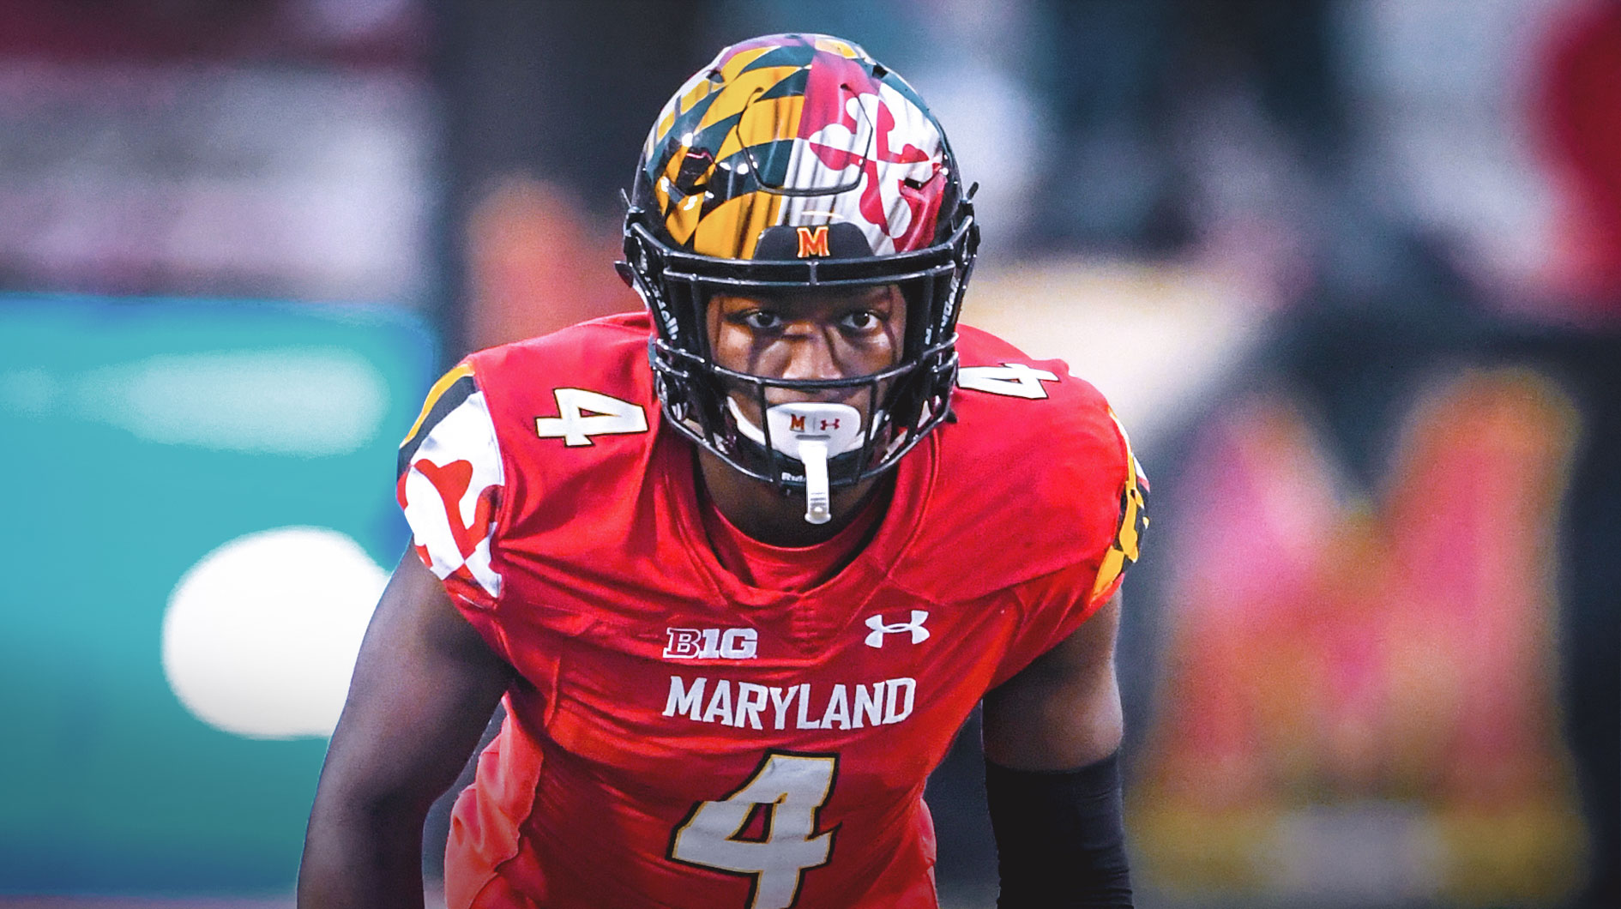
0
Where Did They Go?
Where They Got It Wrong
Irv Smith – 2nd Round – 50th Overall – Minnesota Vikings
7th Worst TE
Darnell Savage – 1st Round – 21th Overall – Green Bay Packers
3rd Worst DB
Trevon Wesco – 4th Round – 121rd Overall – New York Jets
3rd Best TE
Kris Boyd – 7th Round – 217th Overall – Minnesota Vikings
2nd Best DB

Slide 29
QB, WR

Slide 30
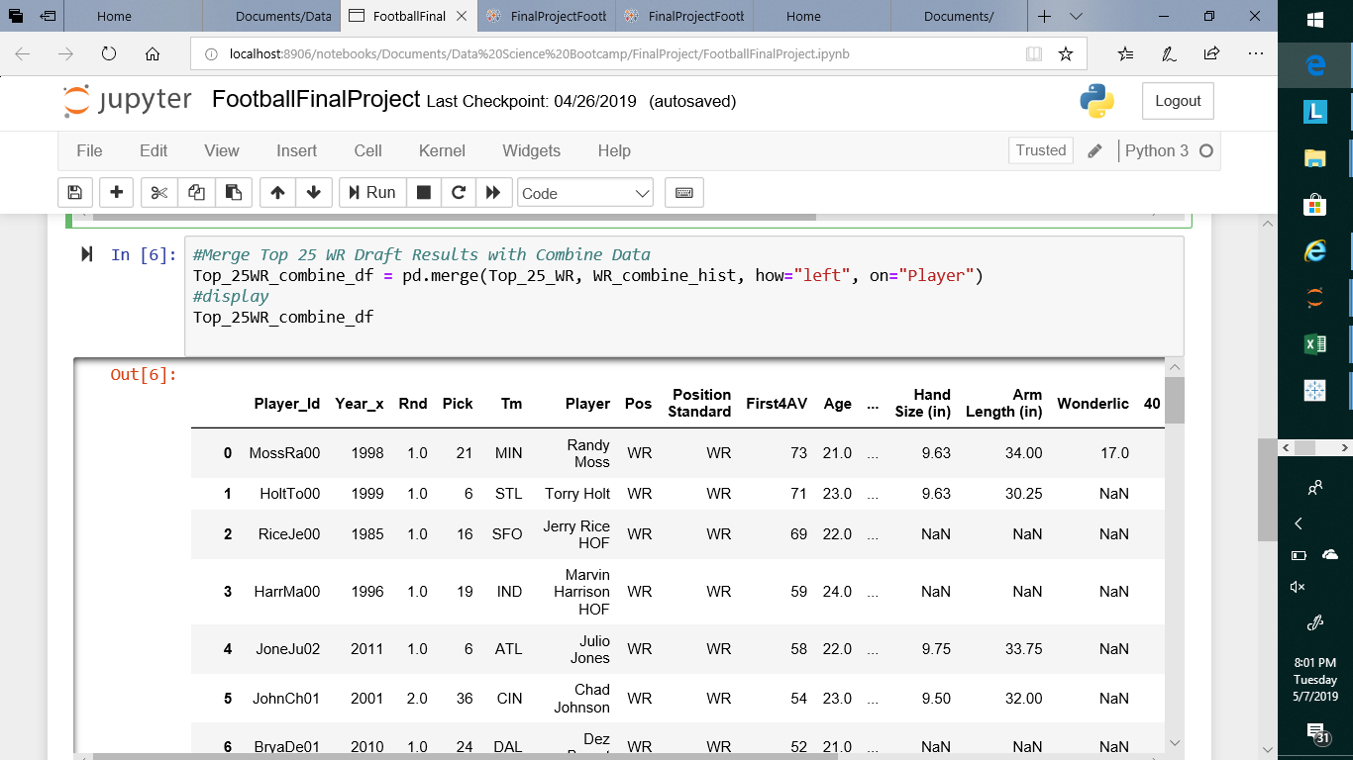
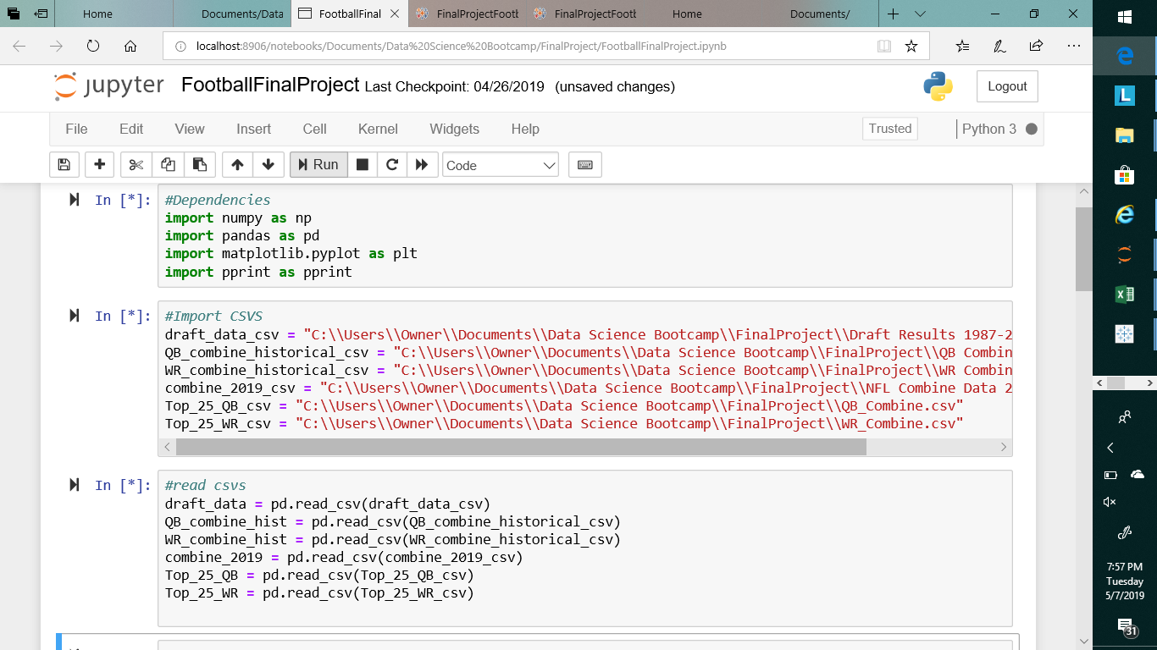
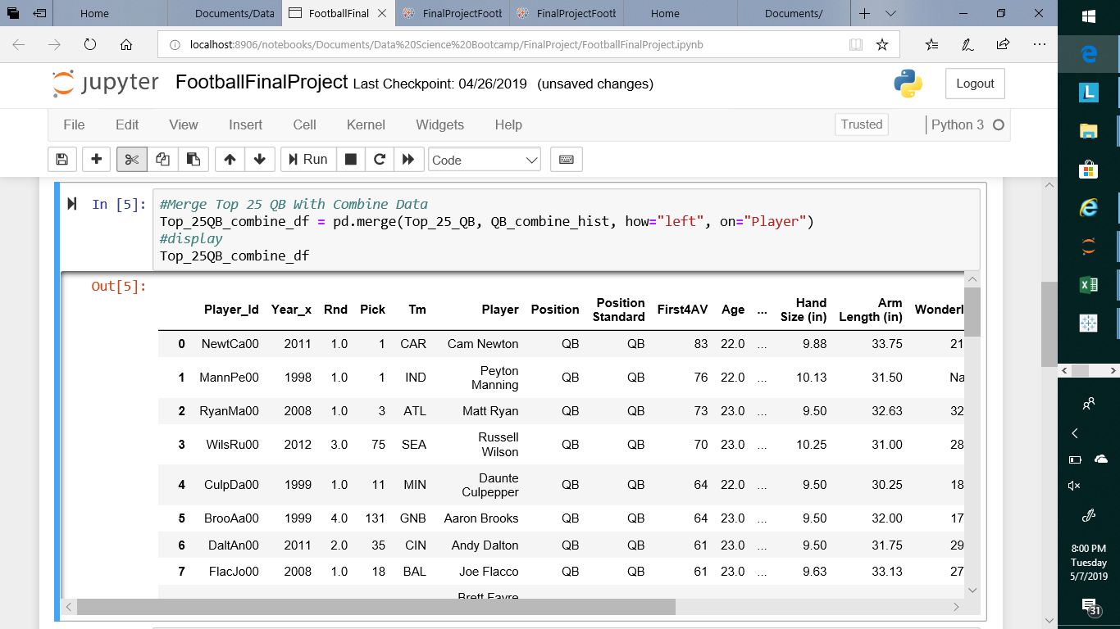
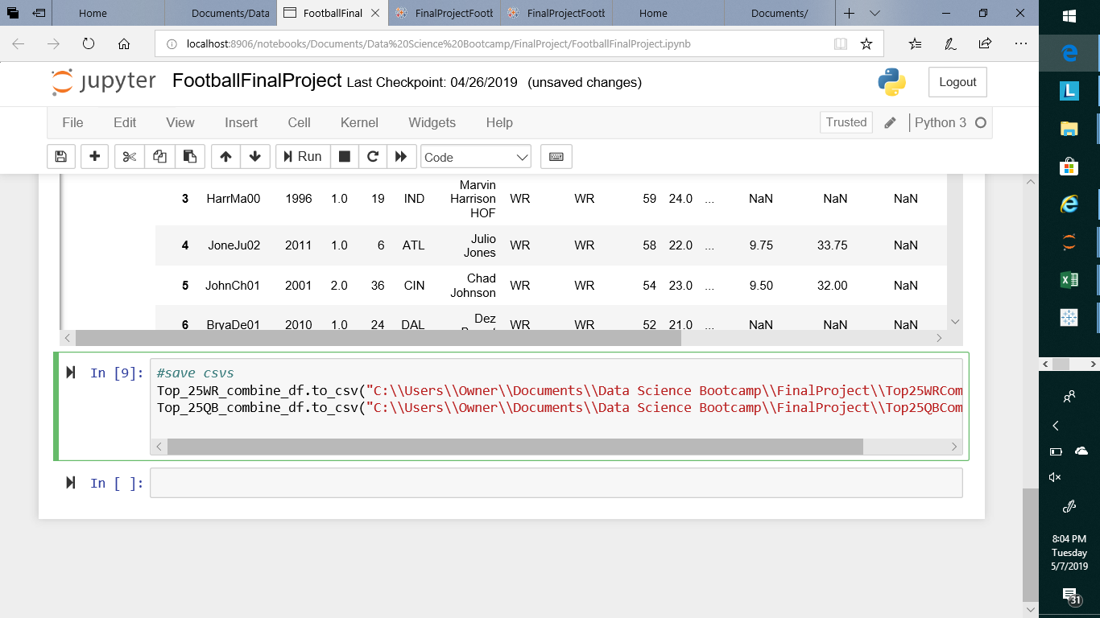

Slide 31
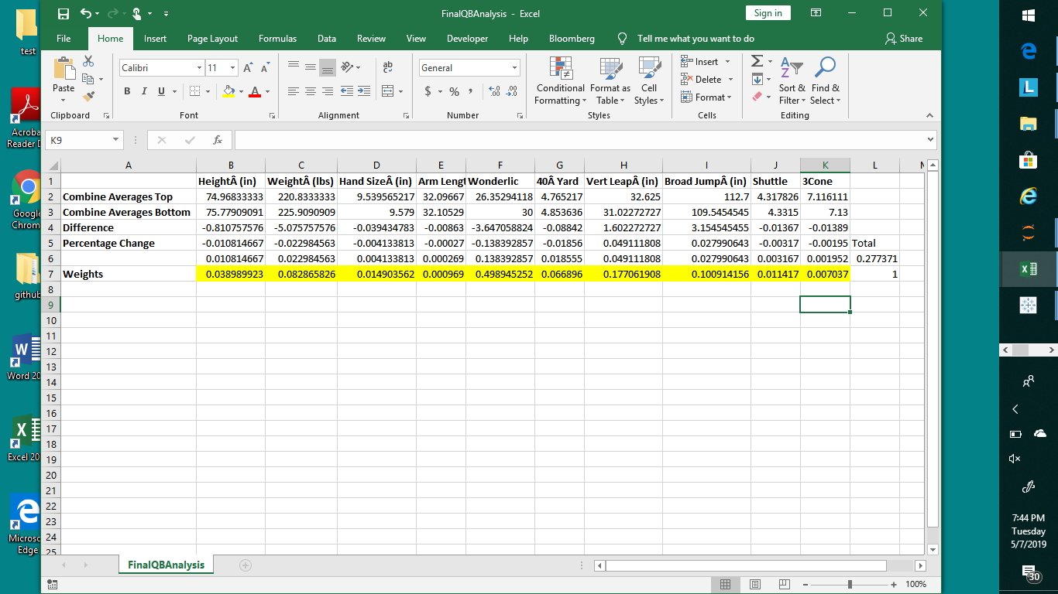
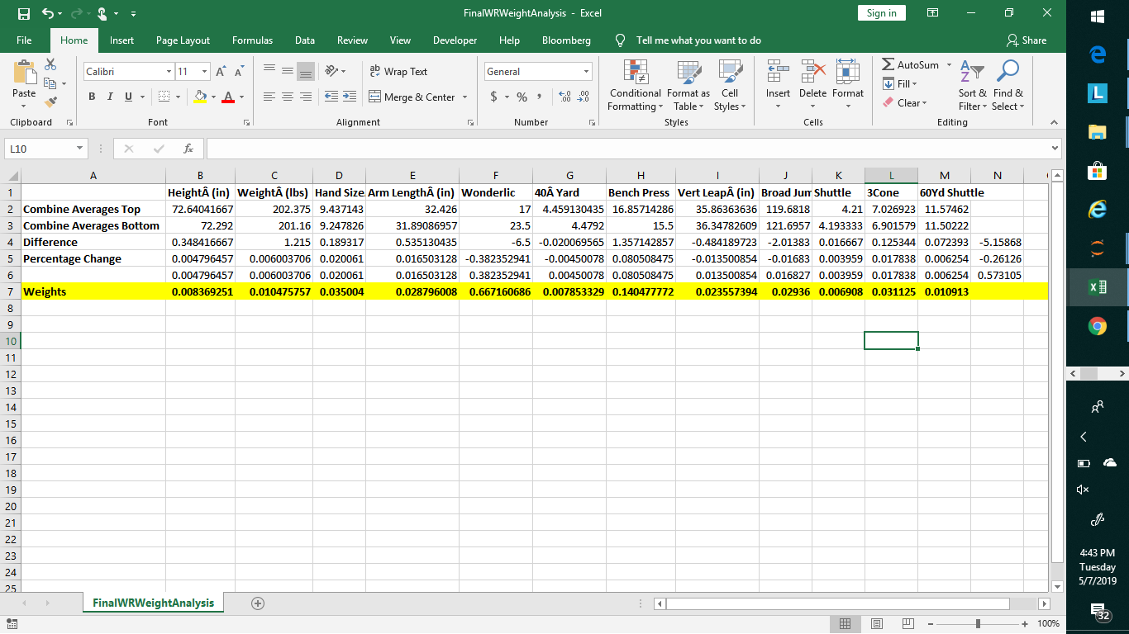
QB Weights
WR Weights

Slide 32
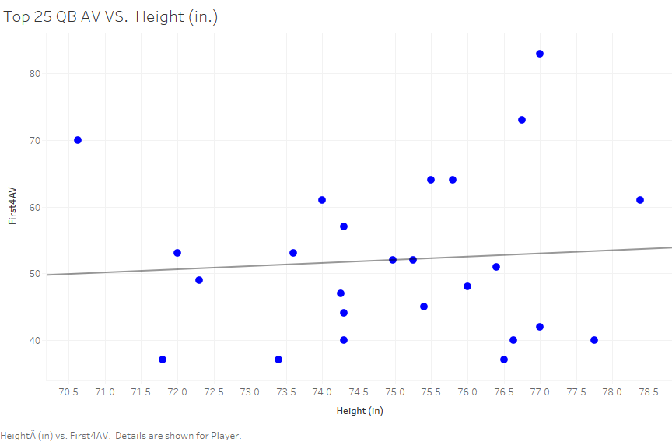

Slide 33
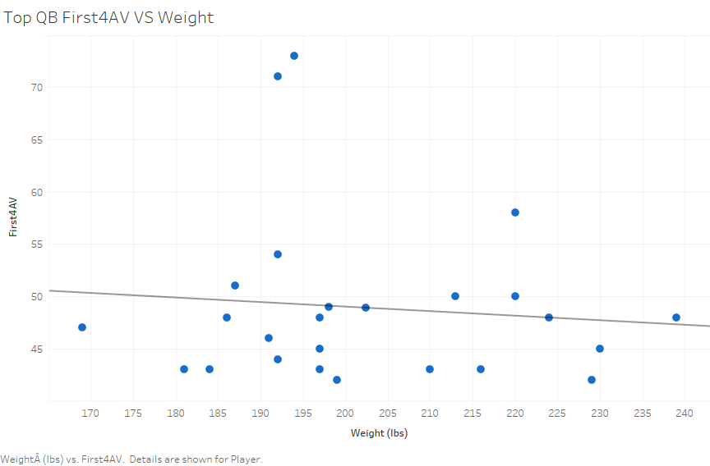

Slide 34
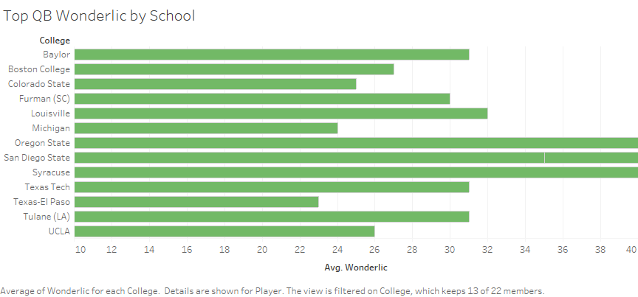

Slide 35
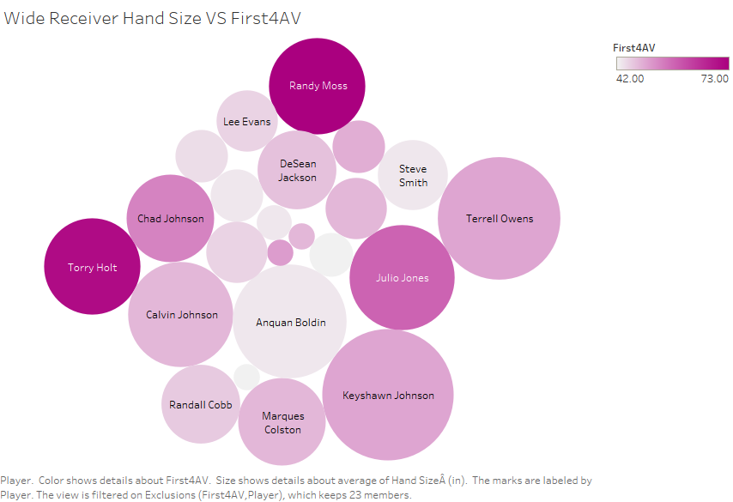

Slide 36
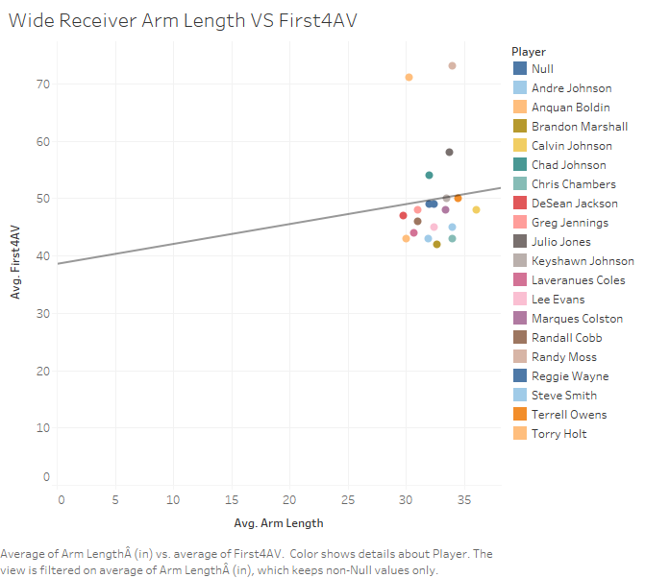

Slide 37
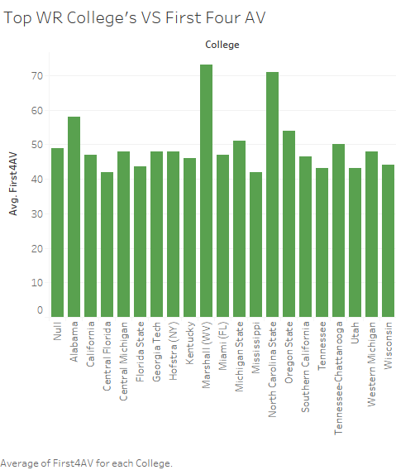

Slide 38
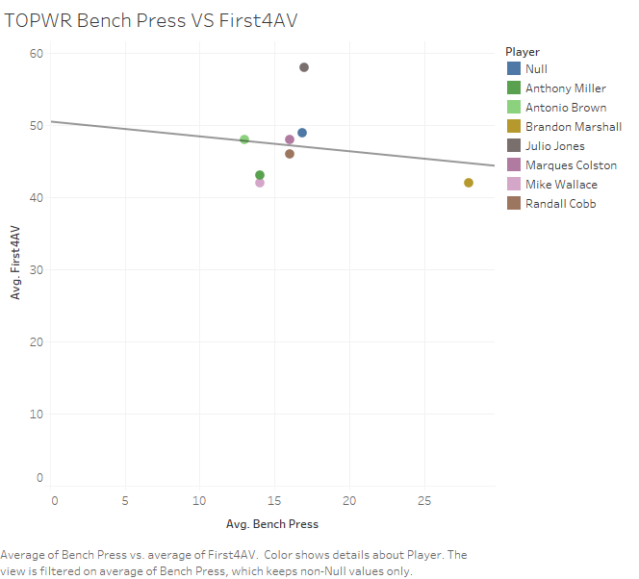

Slide 39
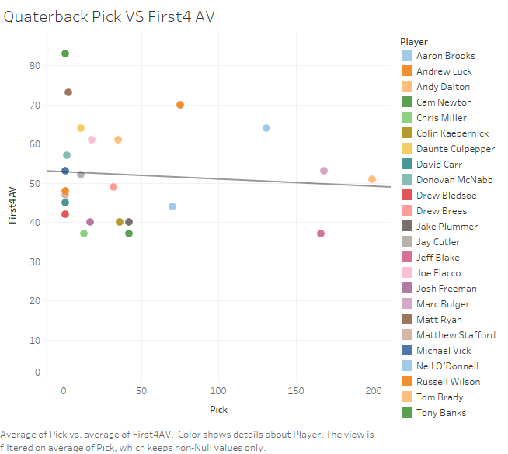

Slide 40
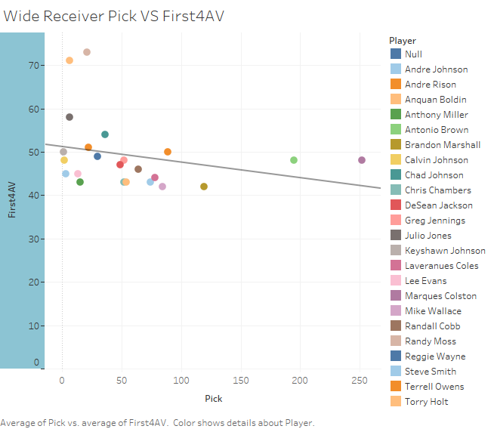

Slide 41
OL, DE

Slide 42
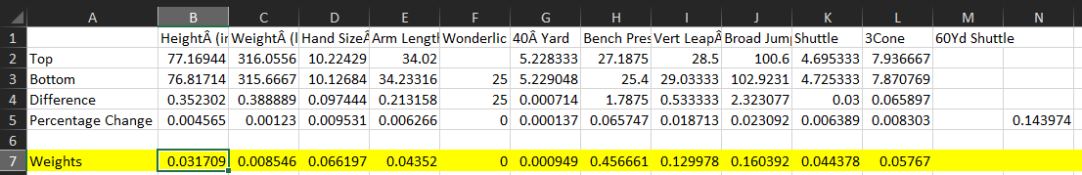
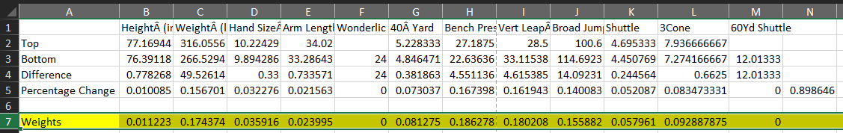
OL Weights
DE Weights

Slide 43
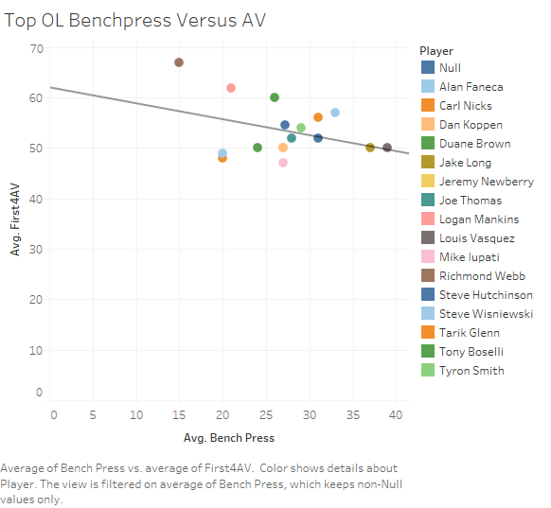

Slide 44
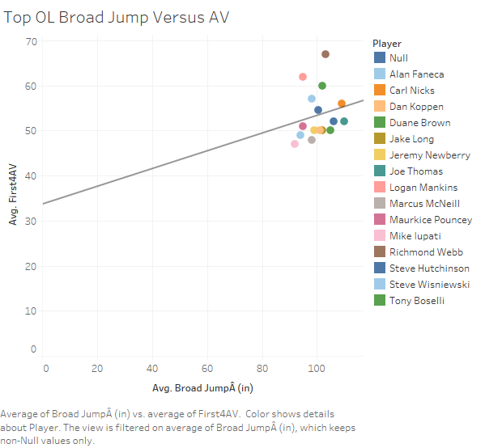

Slide 45
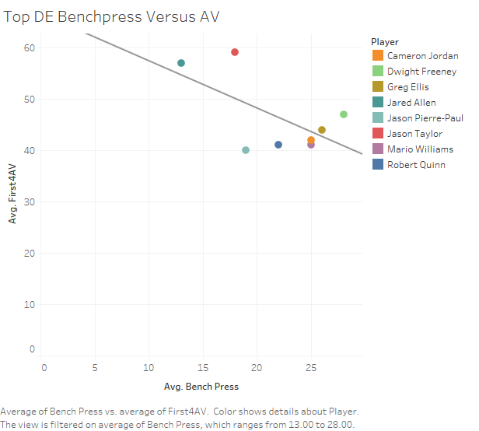

Slide 46
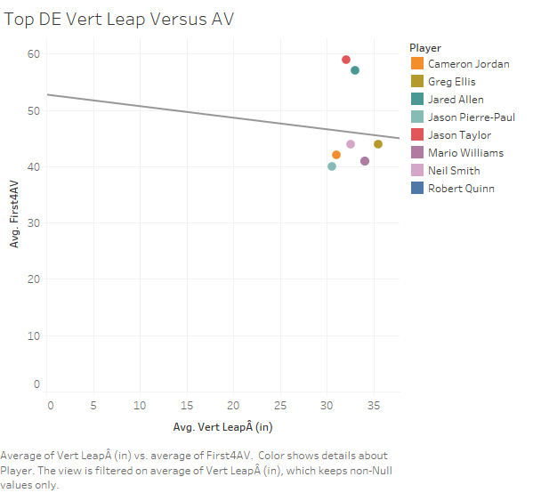

Slide 47
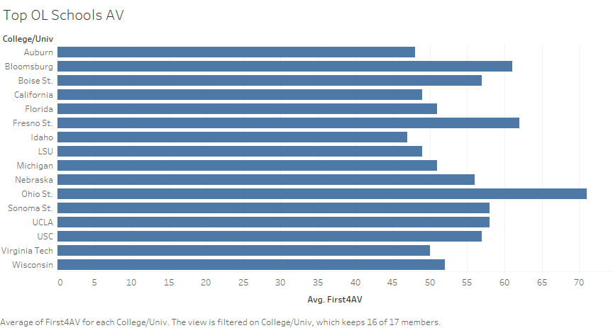

Slide 48
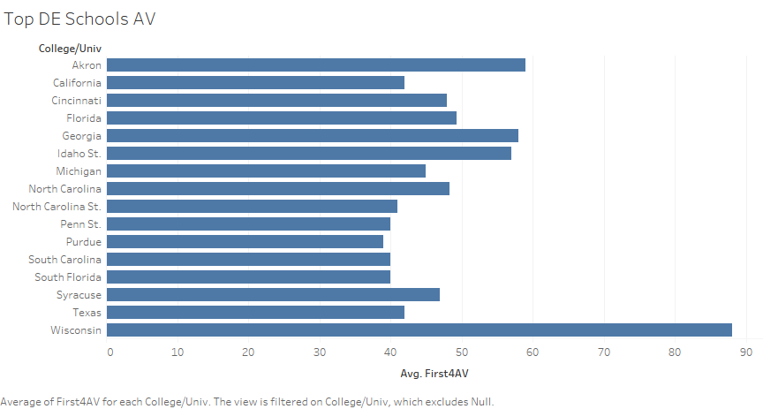

Slide 49
RB, LB

Slide 50
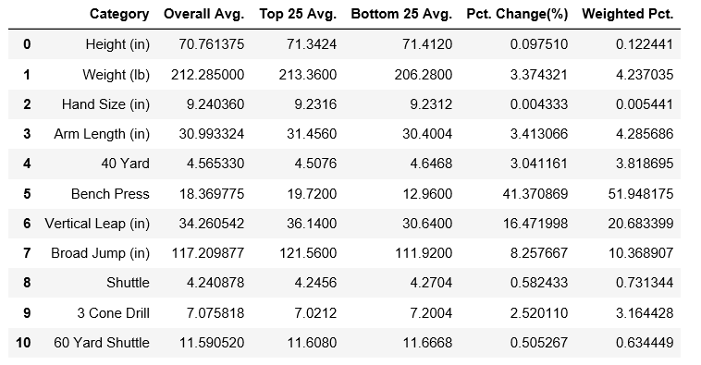

RB Weights
LB Weights

Slide 51
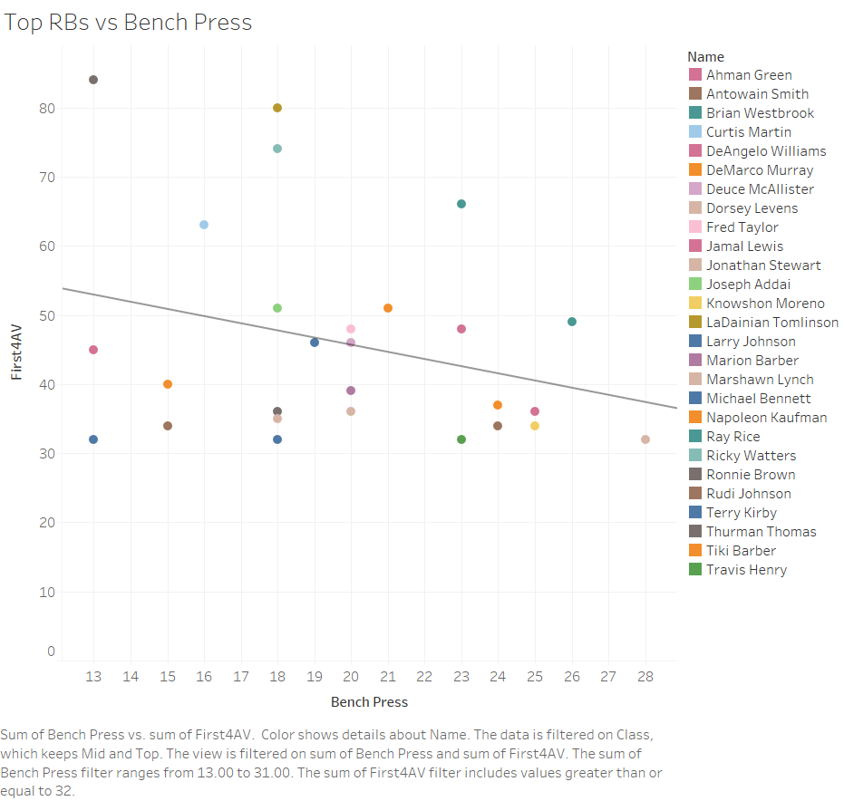

Slide 52


Slide 53


Slide 54


Slide 55
RB Weights
LB Weights

Slide 56


Slide 57


Slide 58


Slide 59


Slide 60
RB New Score Calculation
LB New Score Calculation

Slide 61


Running Back and Linebacker Projections
3
3
3
1
1
3
2
3
3
1
2
3

Slide 62
3
Thank you
Questions?

